Slide 1

Notes:
Frank

Slide 2
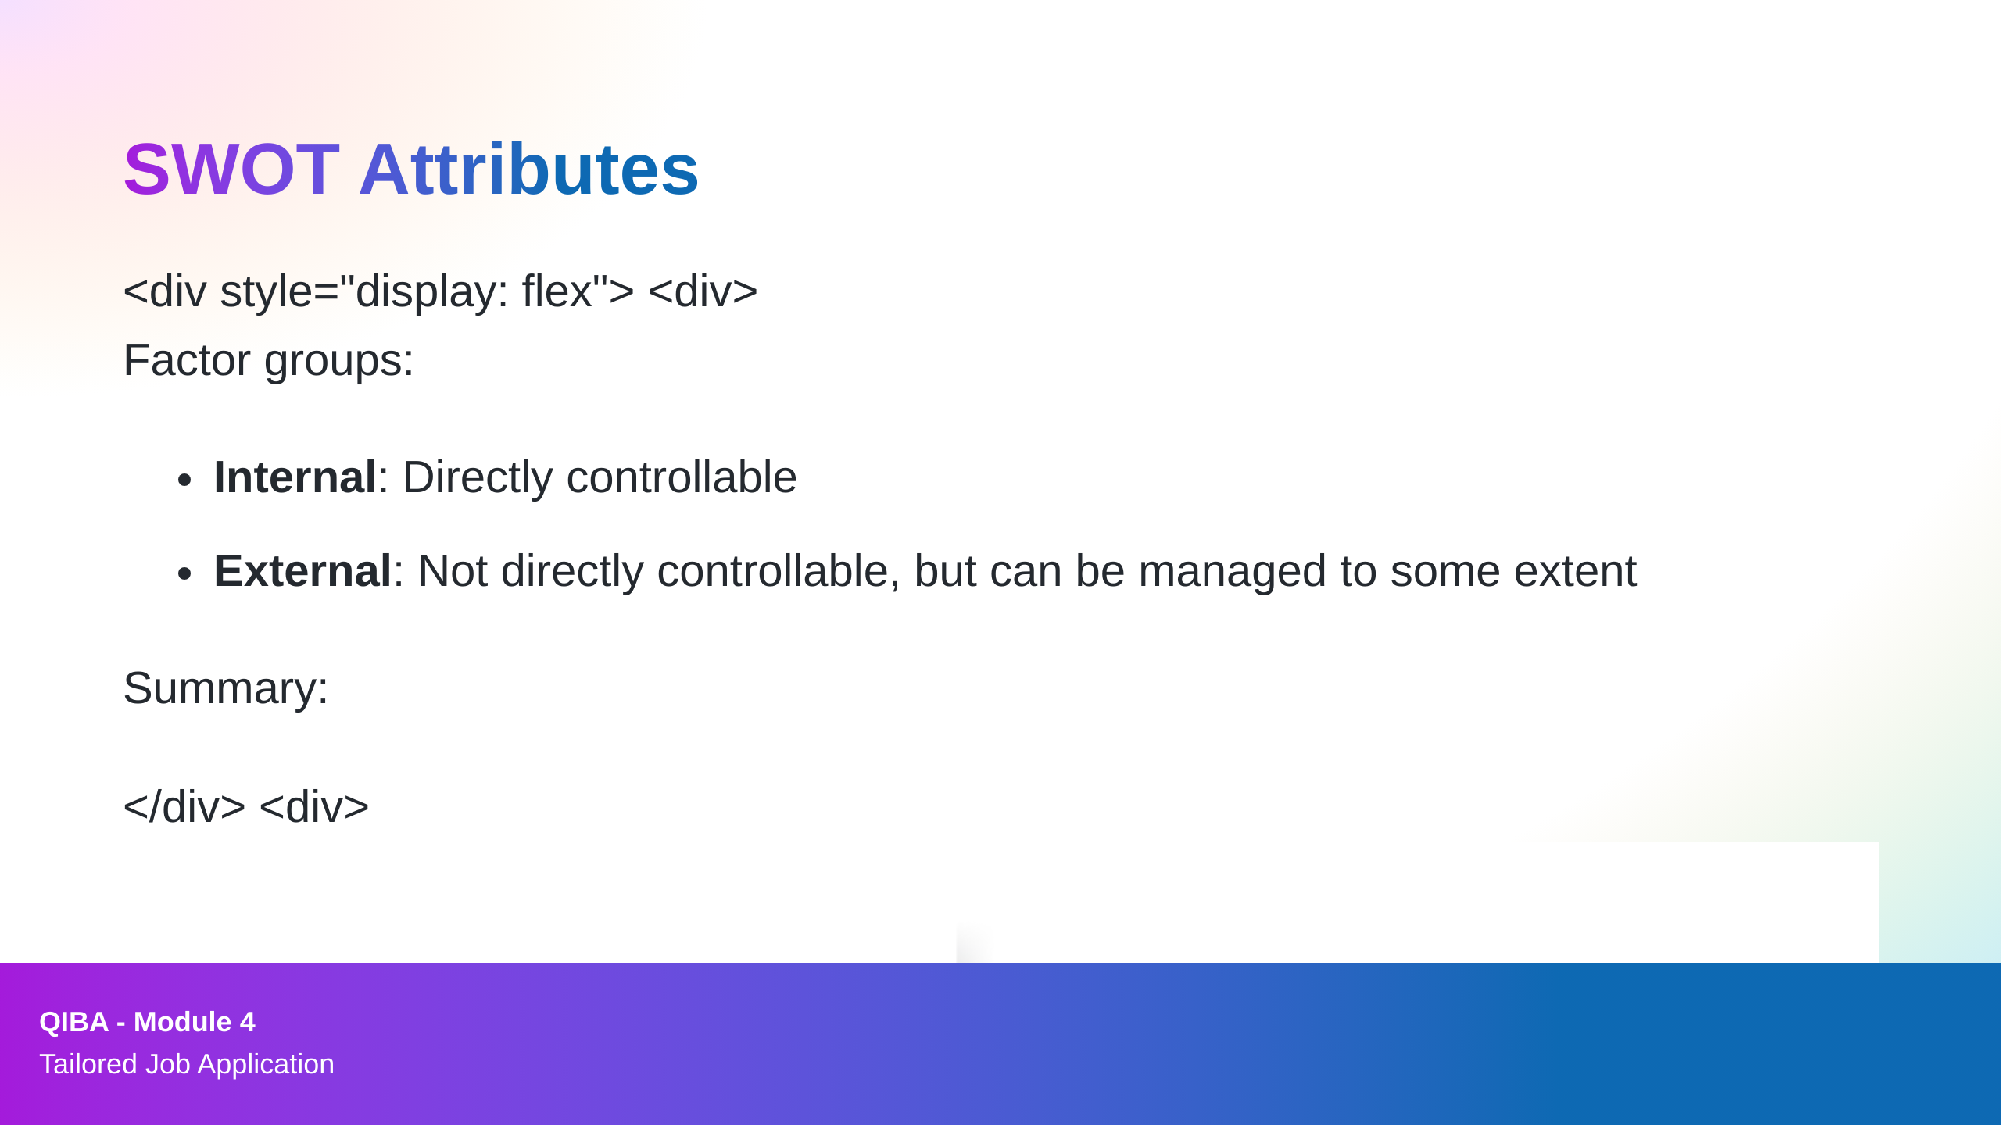
Notes:
Dan

Slide 3
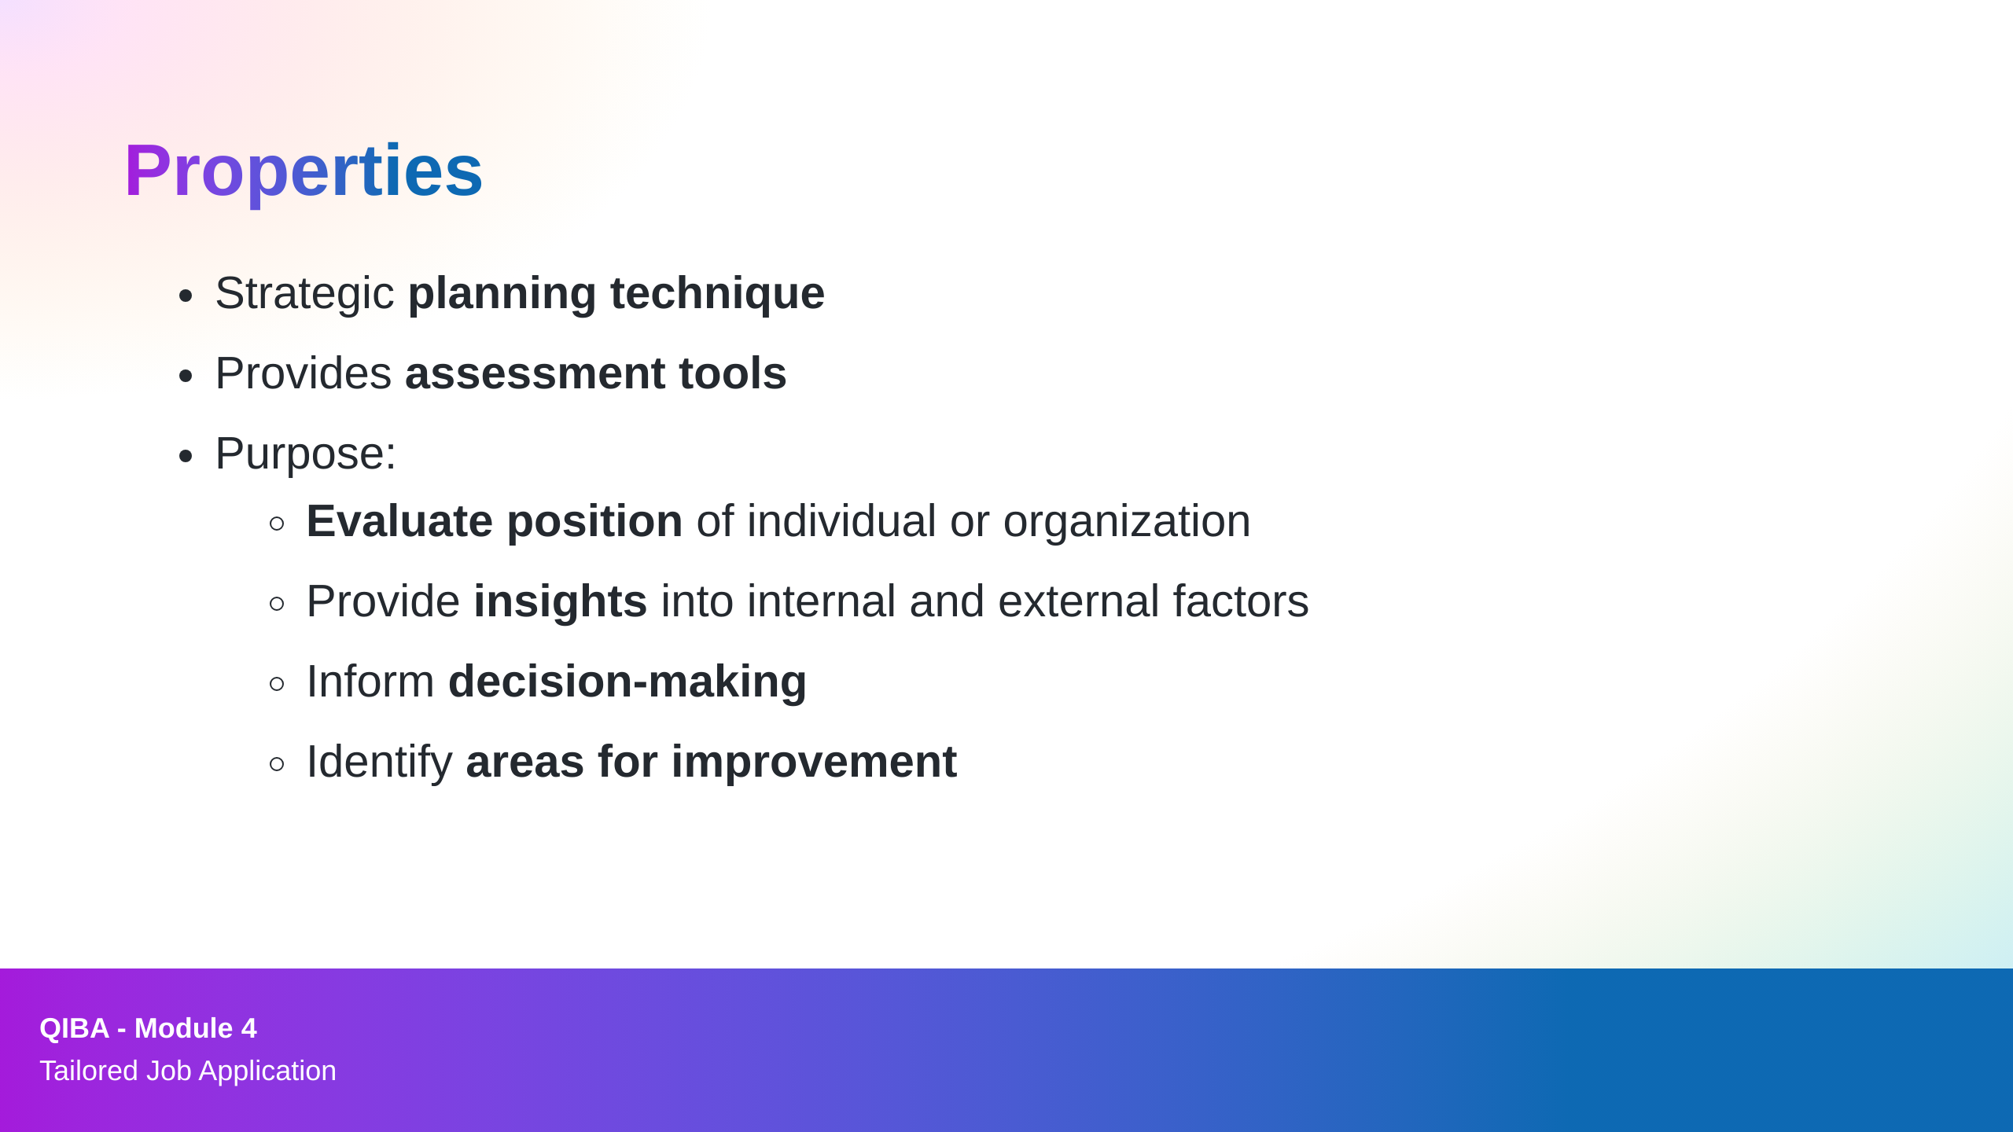
Notes:
Dan

Slide 4

Notes:
Bibek & Harry

Slide 5

Notes:
Bibek & Harry

Slide 6

Notes:
Bibek & Harry

Slide 7

Notes:
Bibek & Harry

Slide 8
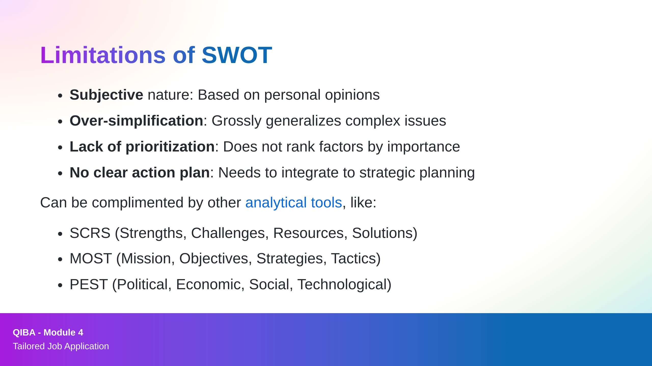
Notes:
Frank

